Slide 1
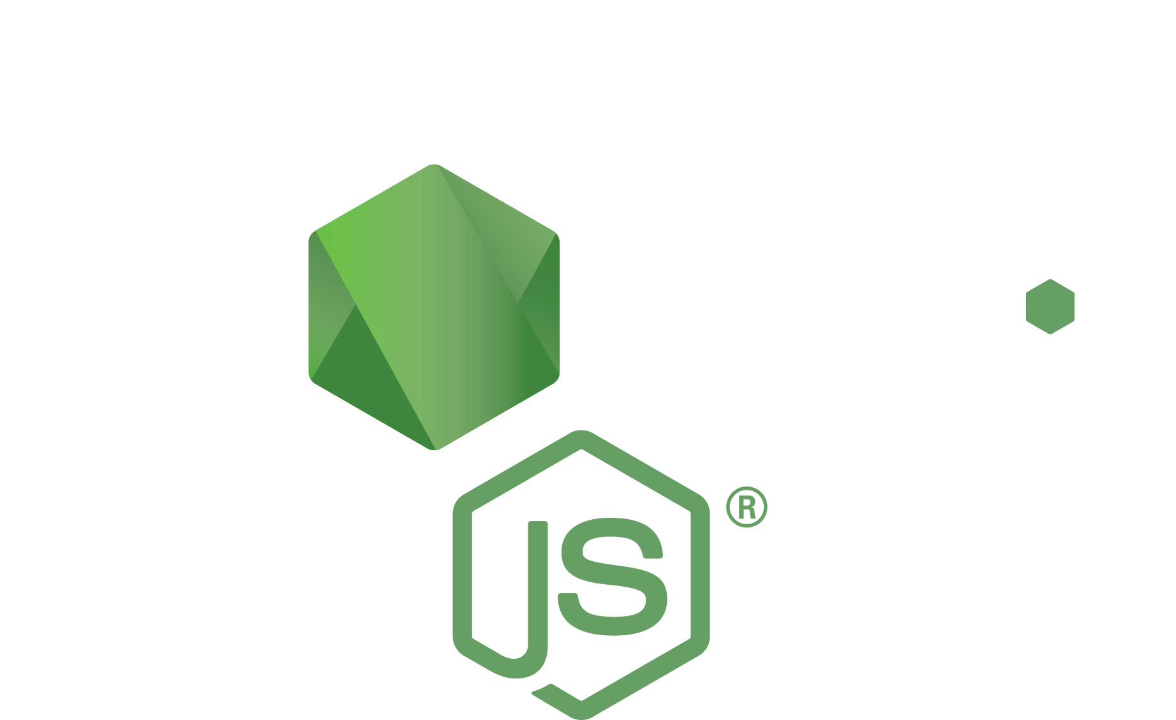



Testing, Mocha, Chai, and you!
Keith Chester
thekeithchester
hlfshell

Slide 2


What we’re talking about tonight
Organizing your code style for testing
Mocking and dependency injection
Building test first

Slide 3
But, why?
Pulling teeth – “tests just slow you down” – not true!
Tests speed up development for future changes
Tests are for other developers – don’t be selfish
Really, I get the “I don’t want to write tests”
…but doing the right thing isn’t always easy

Slide 4
What actually happens
“I’ll just quickly code this up” – who hasn’t said this?
which leads to…
…a few hours testing the feature, making a slight change, rinse and repeat until it works. Then…
…needing to add a new feature/change which ends up breaking functionality of an old feature.
Debugging doesn’t have to be a game of clue.

Slide 5
BDD and TDD
BDD
TDD
Behavior Driven Development
Tests read like a sentence
Supposedly fixes “missing the forest for the trees” of TDD
Test Driven Developmen
Small unit tests
Exactly tuned to function output
I will be assuming BDD moving forward, but you can use either

Slide 6
Introducing mocha
Testing framework
Handles your written assertion of a test passing or failing – that’s it

Slide 7
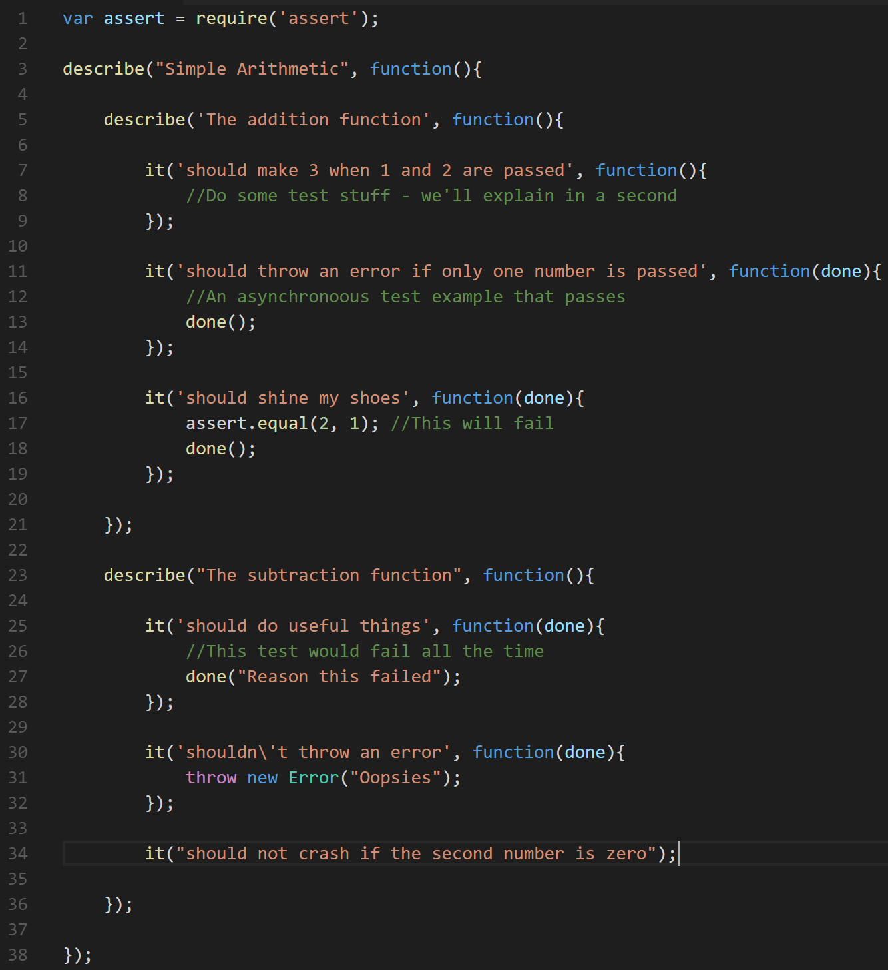
oc at its simplest

Slide 8
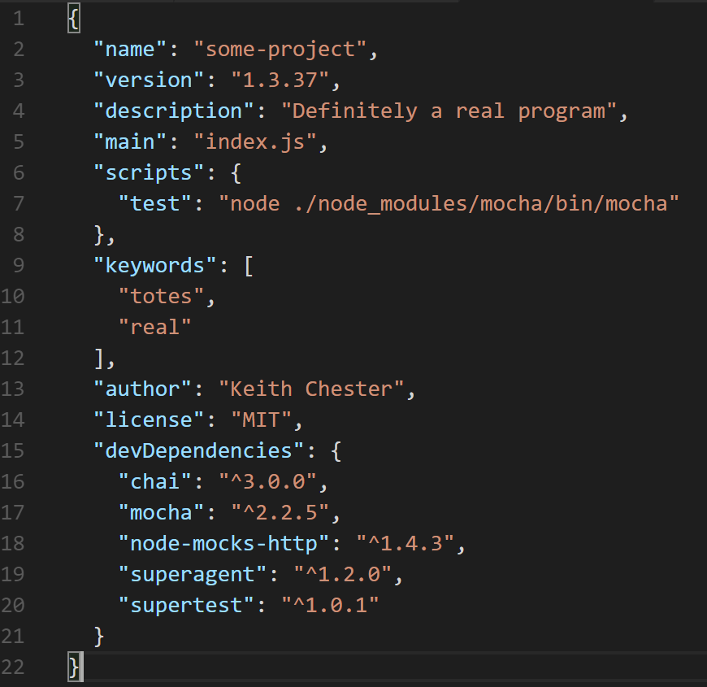
Setting up Ma

Slide 9
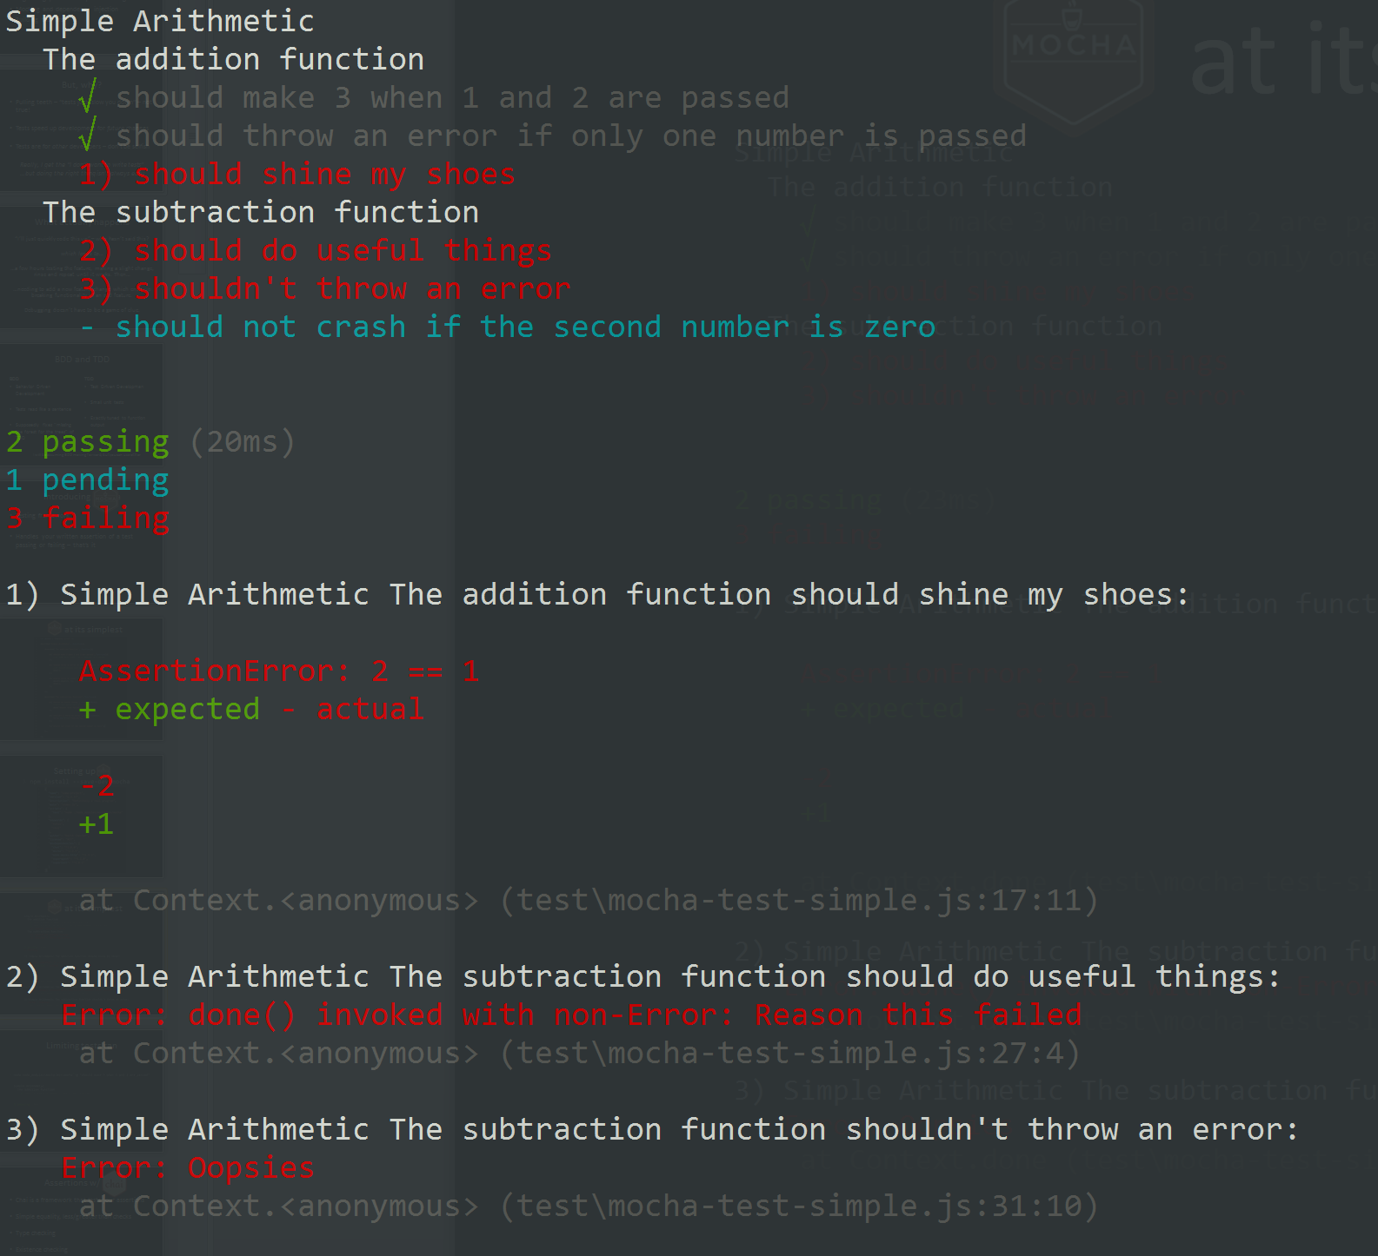
oc at its simplest

Slide 10
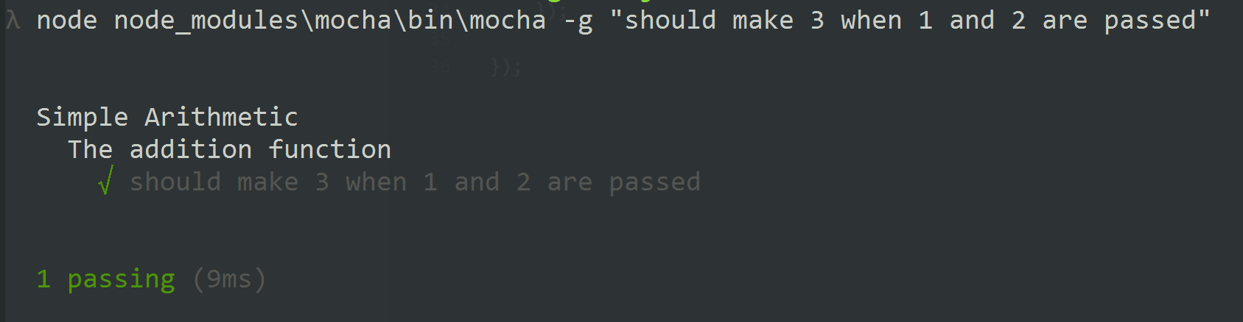
Limiting tests ran

Slide 11
Assertions w/ chai
Chai is a framework that tests your assertions
Simple equality, less/greater than checks
Type checking
Existence checking
Expected thrown errors

Slide 12
Chai and BDD/TDD
BDD
TDD
Should
Expect
Assert
The only difference is your preferred language (mostly)

Slide 13

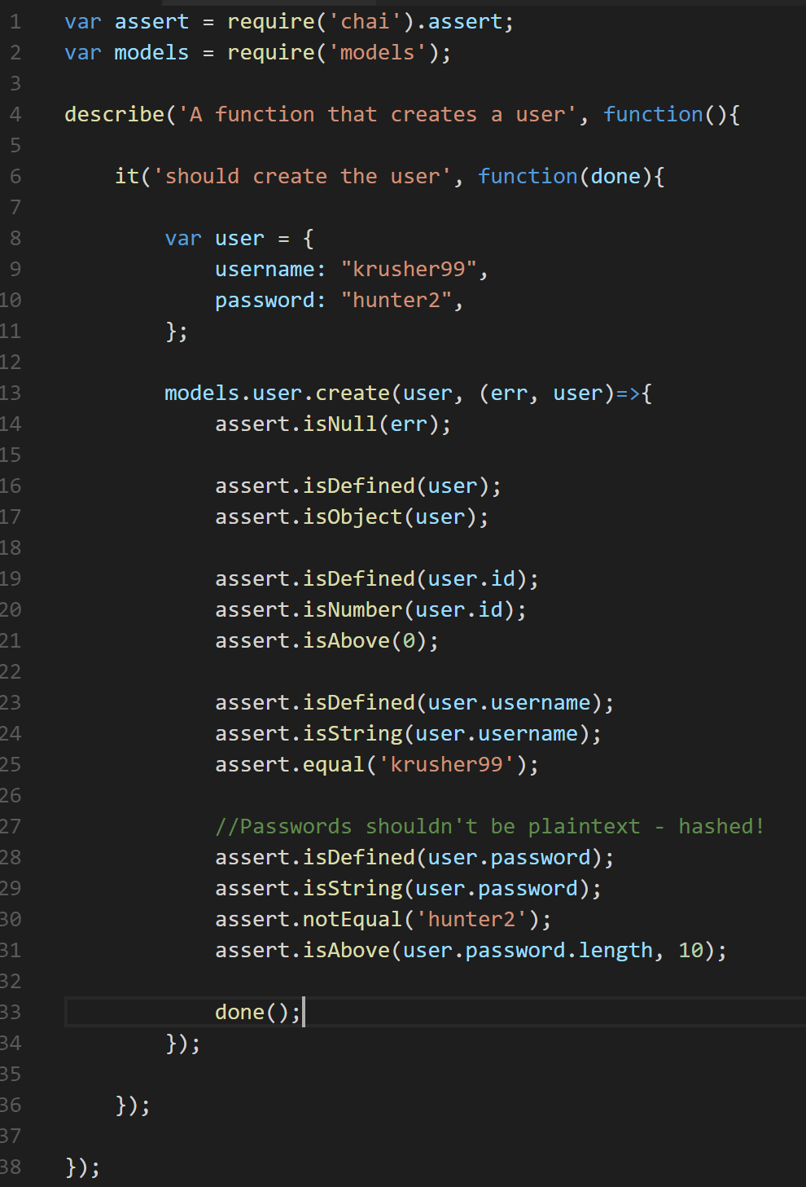
assert in Chai

Slide 14
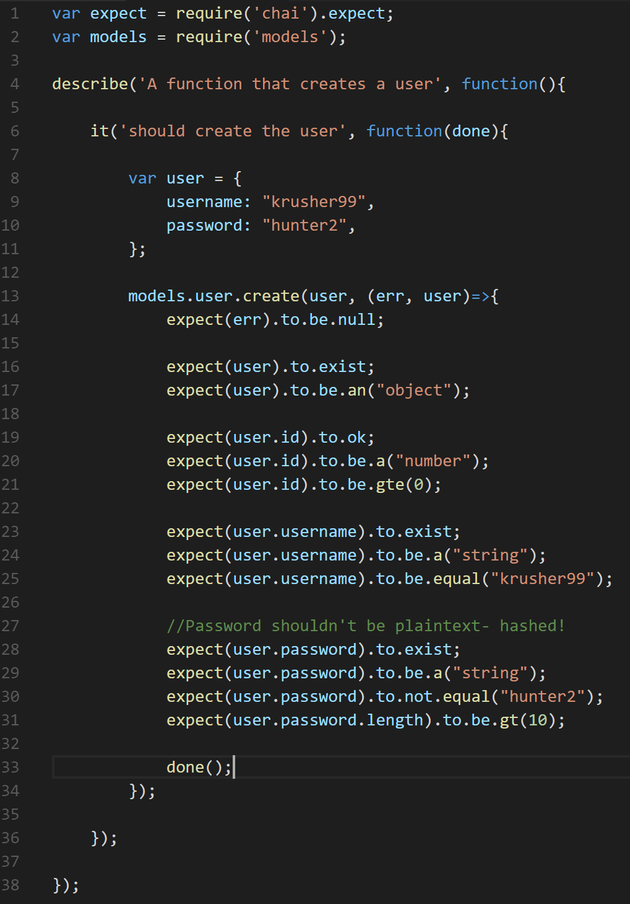
expect in Chai

Slide 15
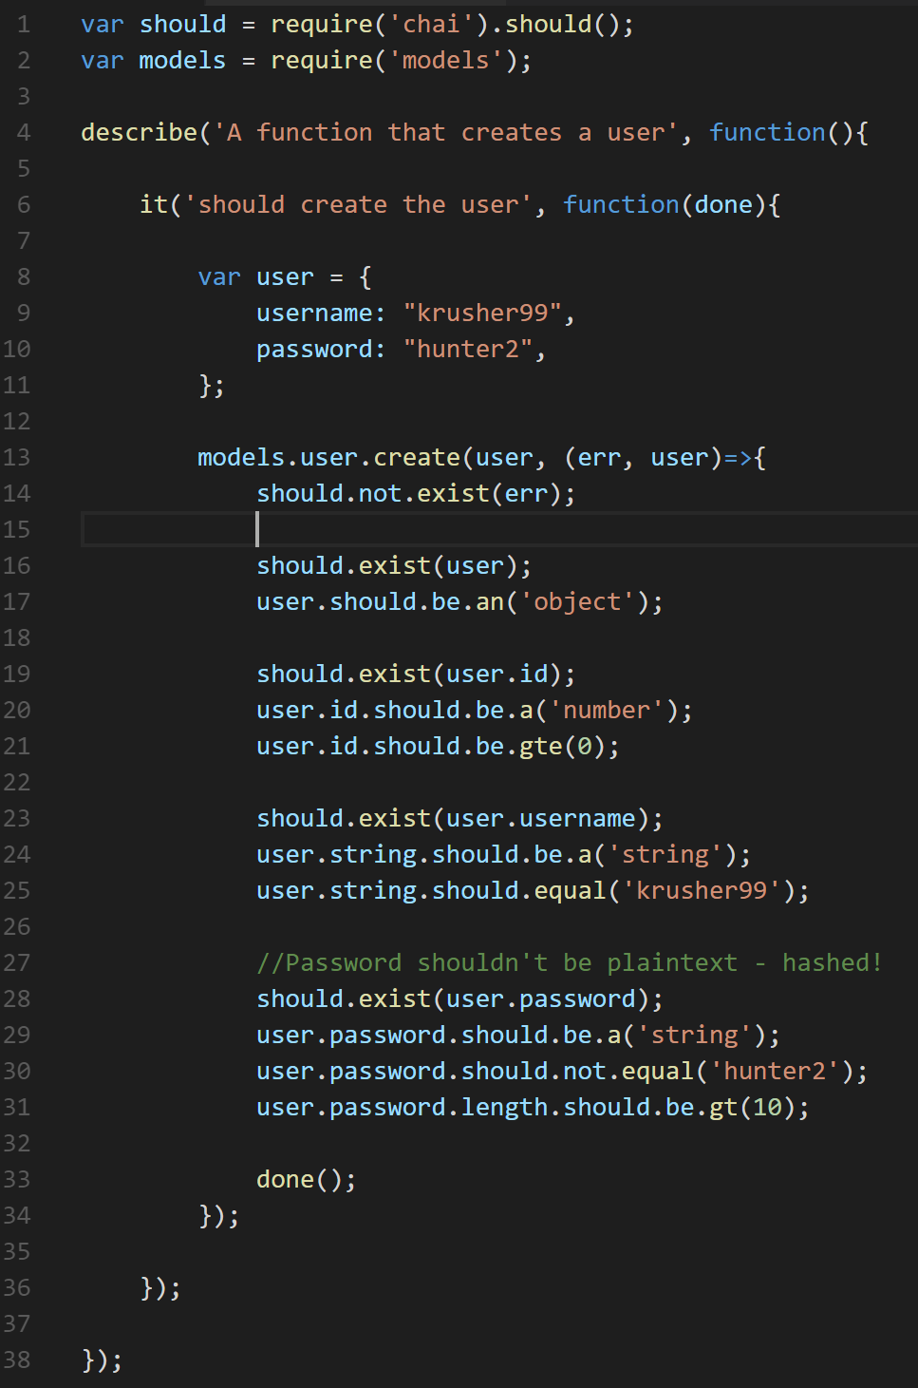
should in Chai

Slide 16
Theory vs Practice
Now you know the basics
Let’s apply it to something a little more real-worldly

Slide 17
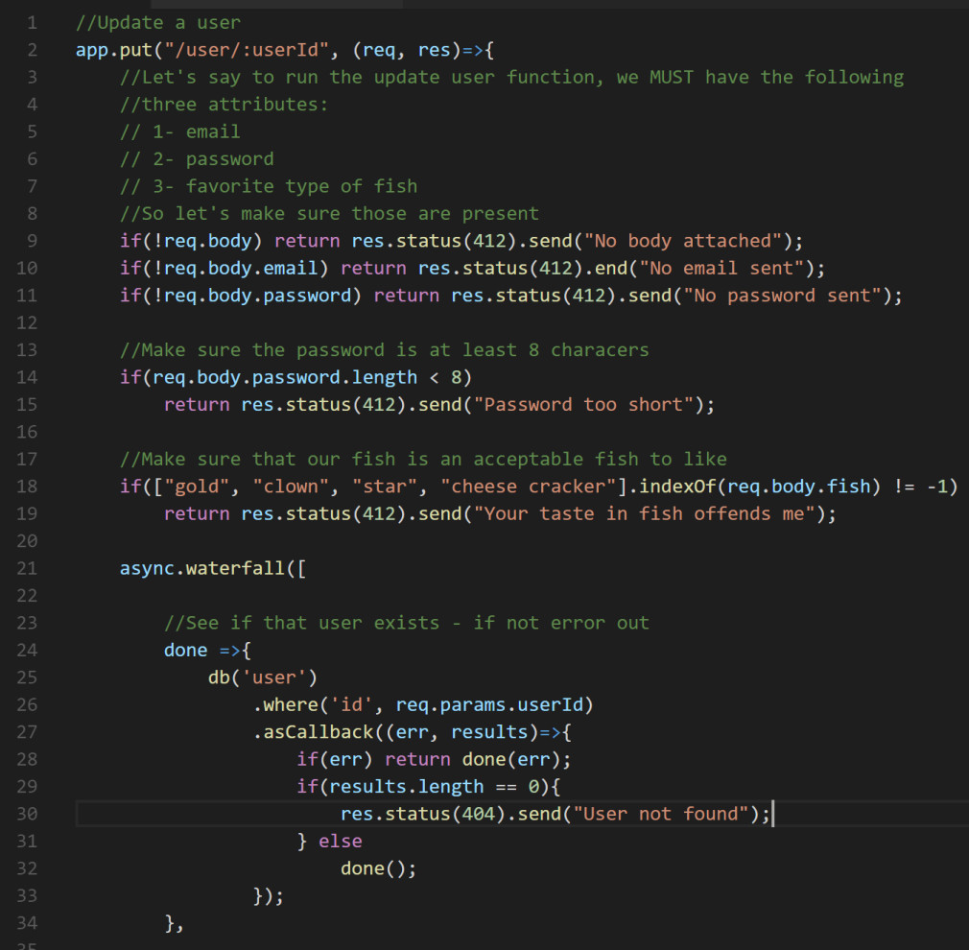
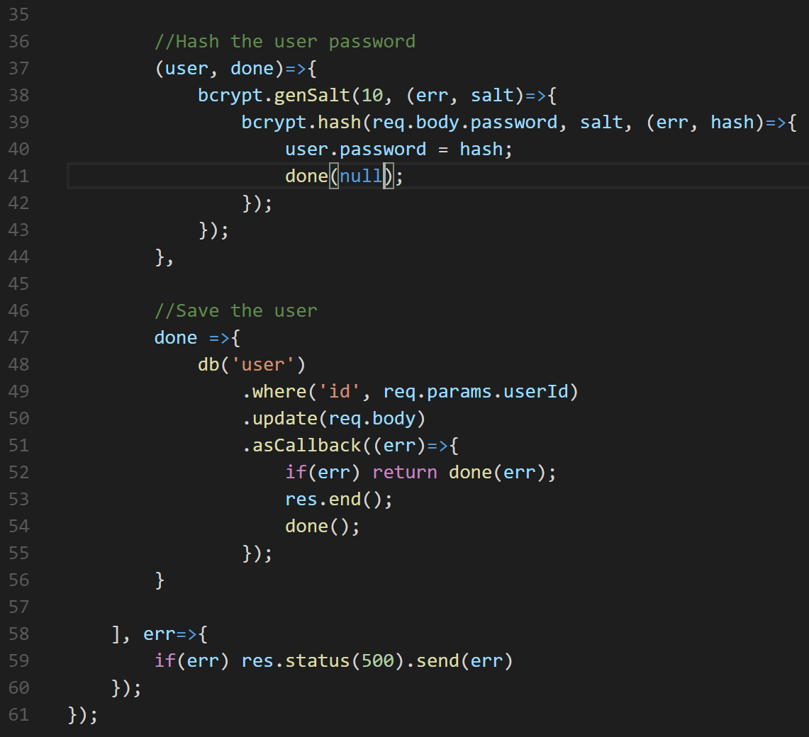
A quite unremarkable Express route

Slide 18
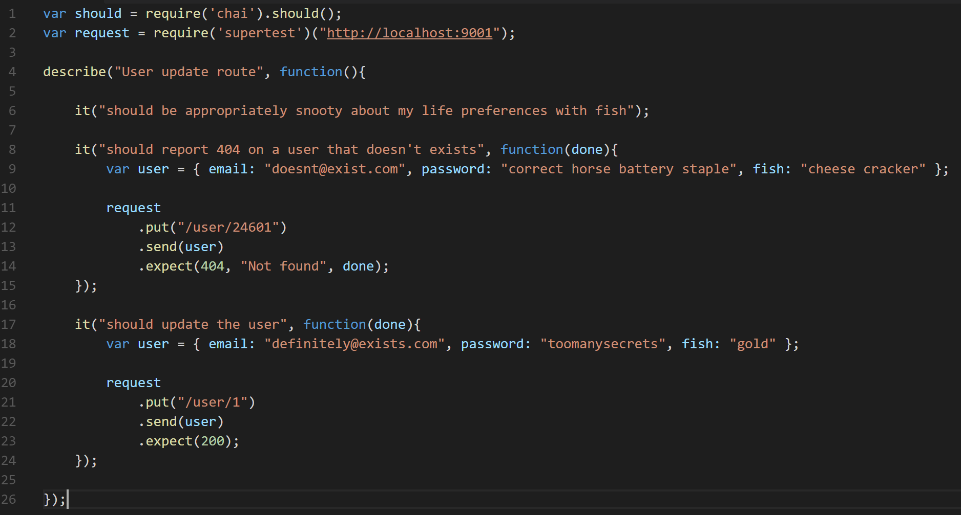
Write a test to actually hit the endpoint
Run the server on a known port, then run mocha

Slide 19
This isn’t ideal most of the time. Why?
Annoying extra step to run the server
You end up testing the same steps over and over!
Exceptions being thrown brings down the server, but not caught by mocha
We don’t know which test caused the crash
This brings down ALL of your tests
You’re testing too many things at once!
Validation
Getting the user
Saving the user

Slide 20

Test small functions, not monoliths

Slide 21
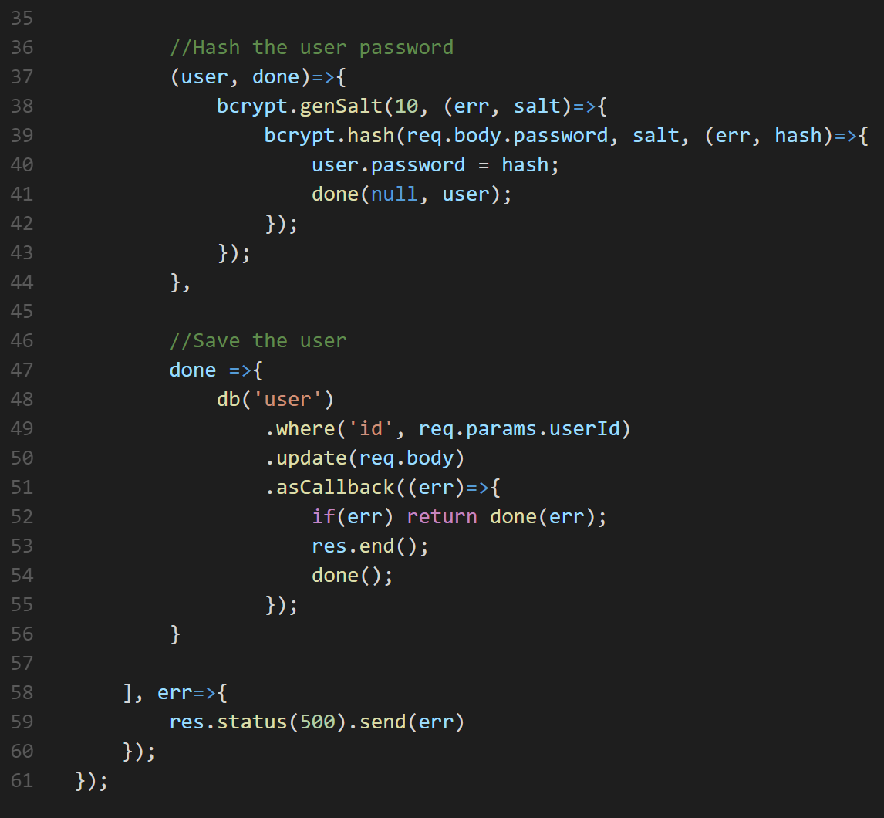
For reference – our entirely unremarkable Express route

Slide 22
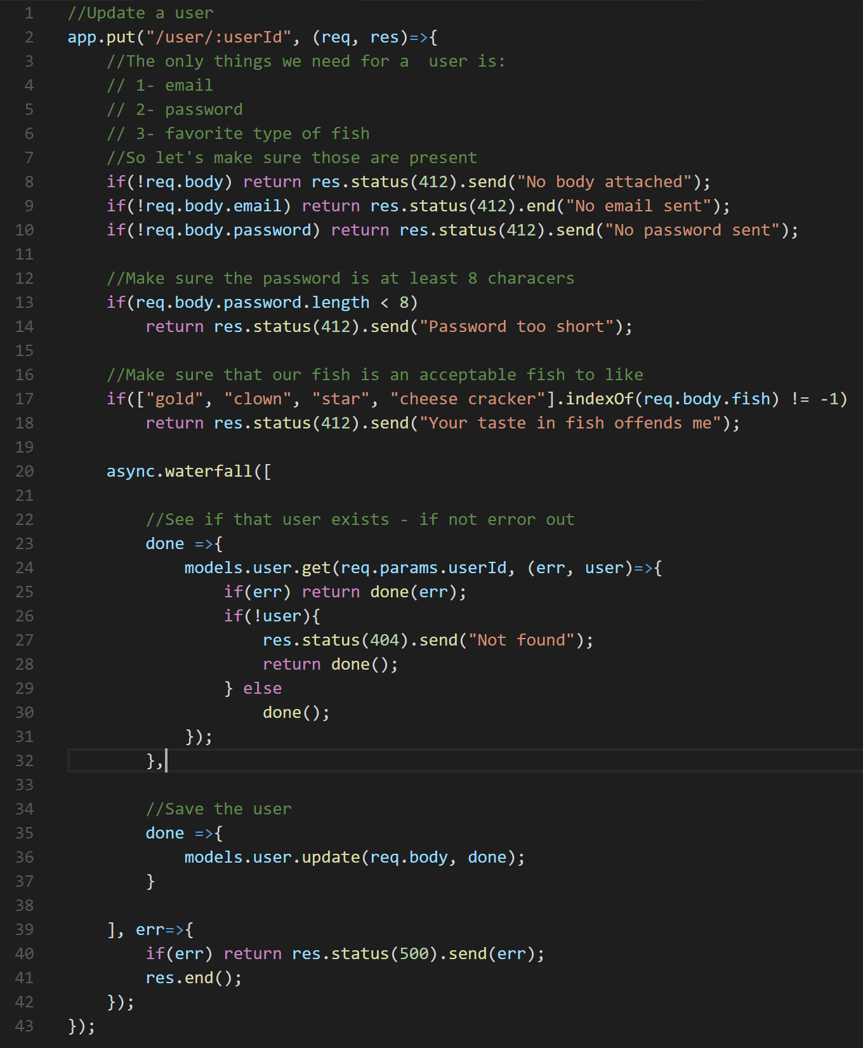
Break out functionality – step 1 – the model

Slide 23
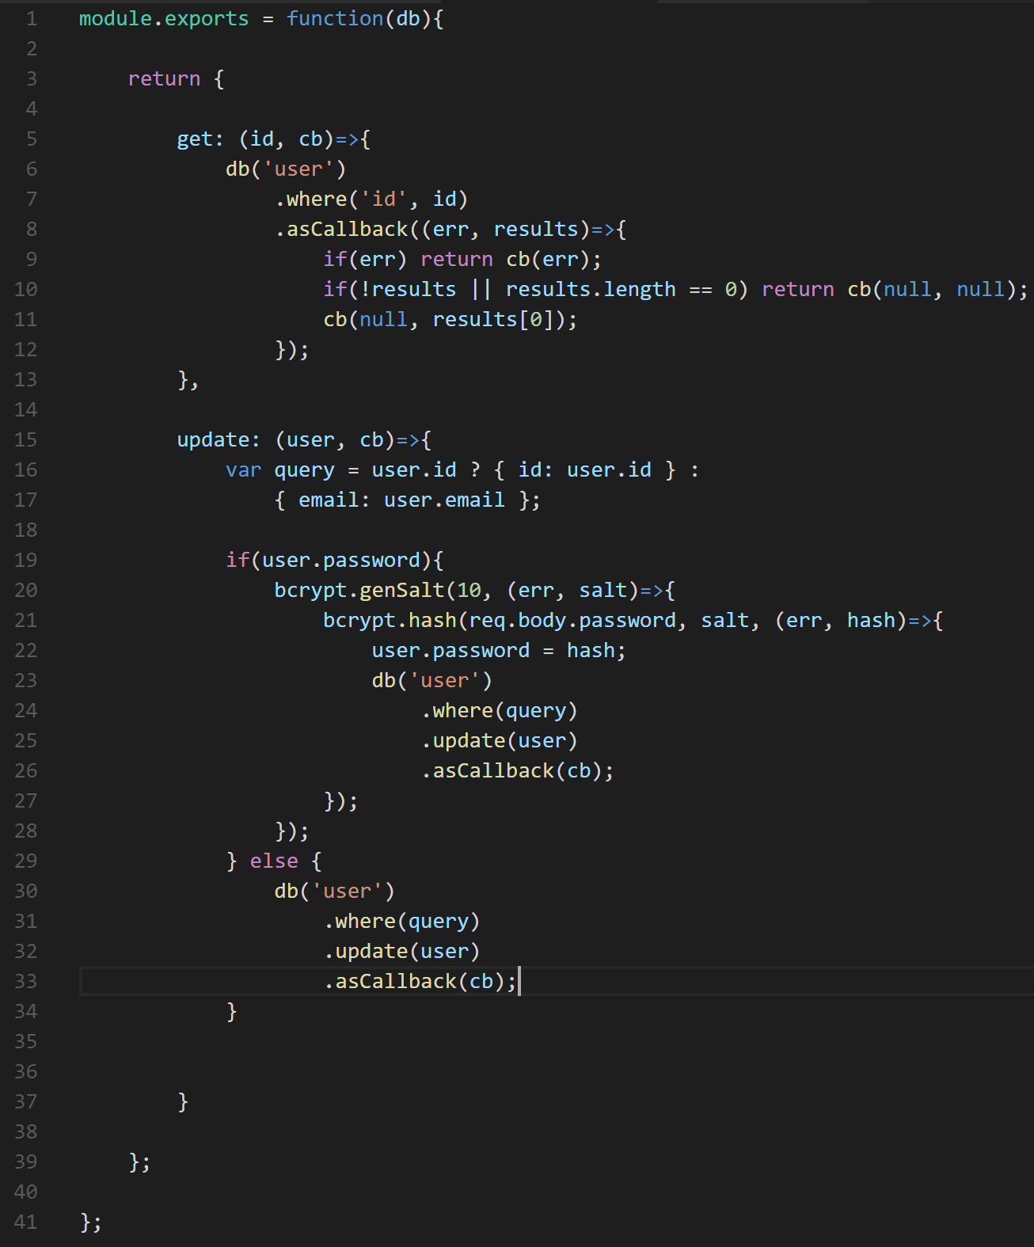
The model

Slide 24
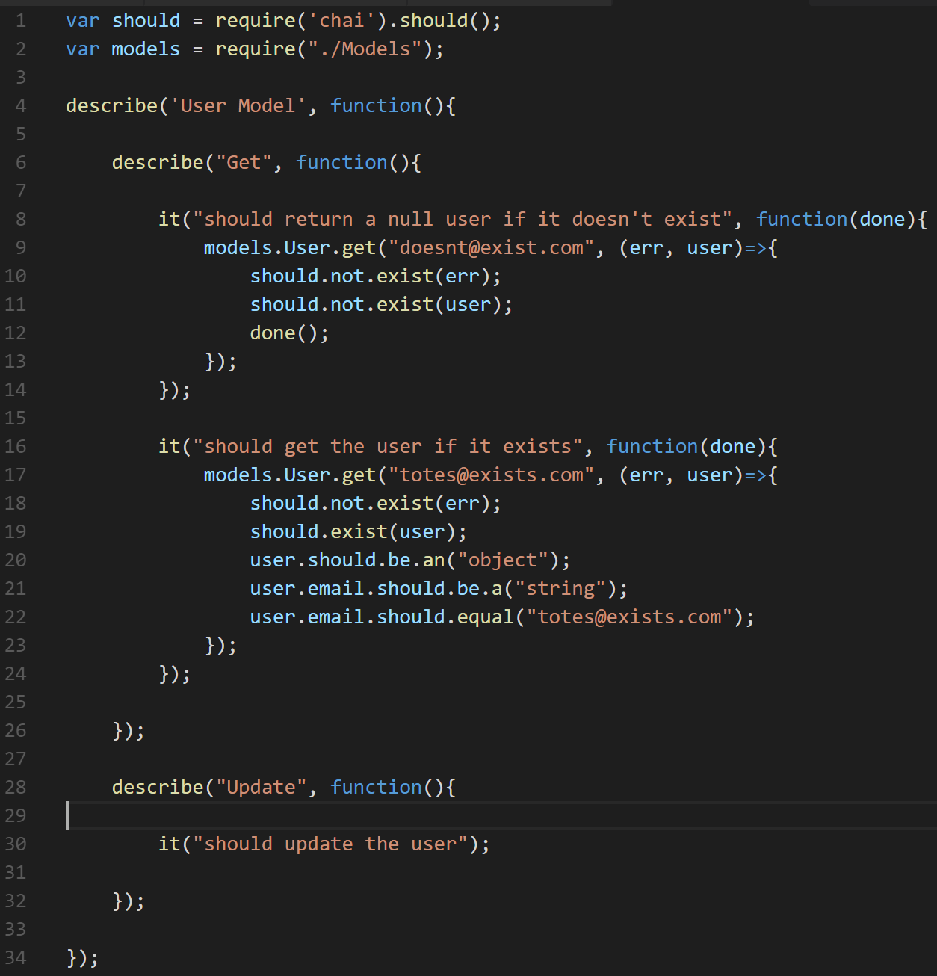
Test that model separately

Slide 25
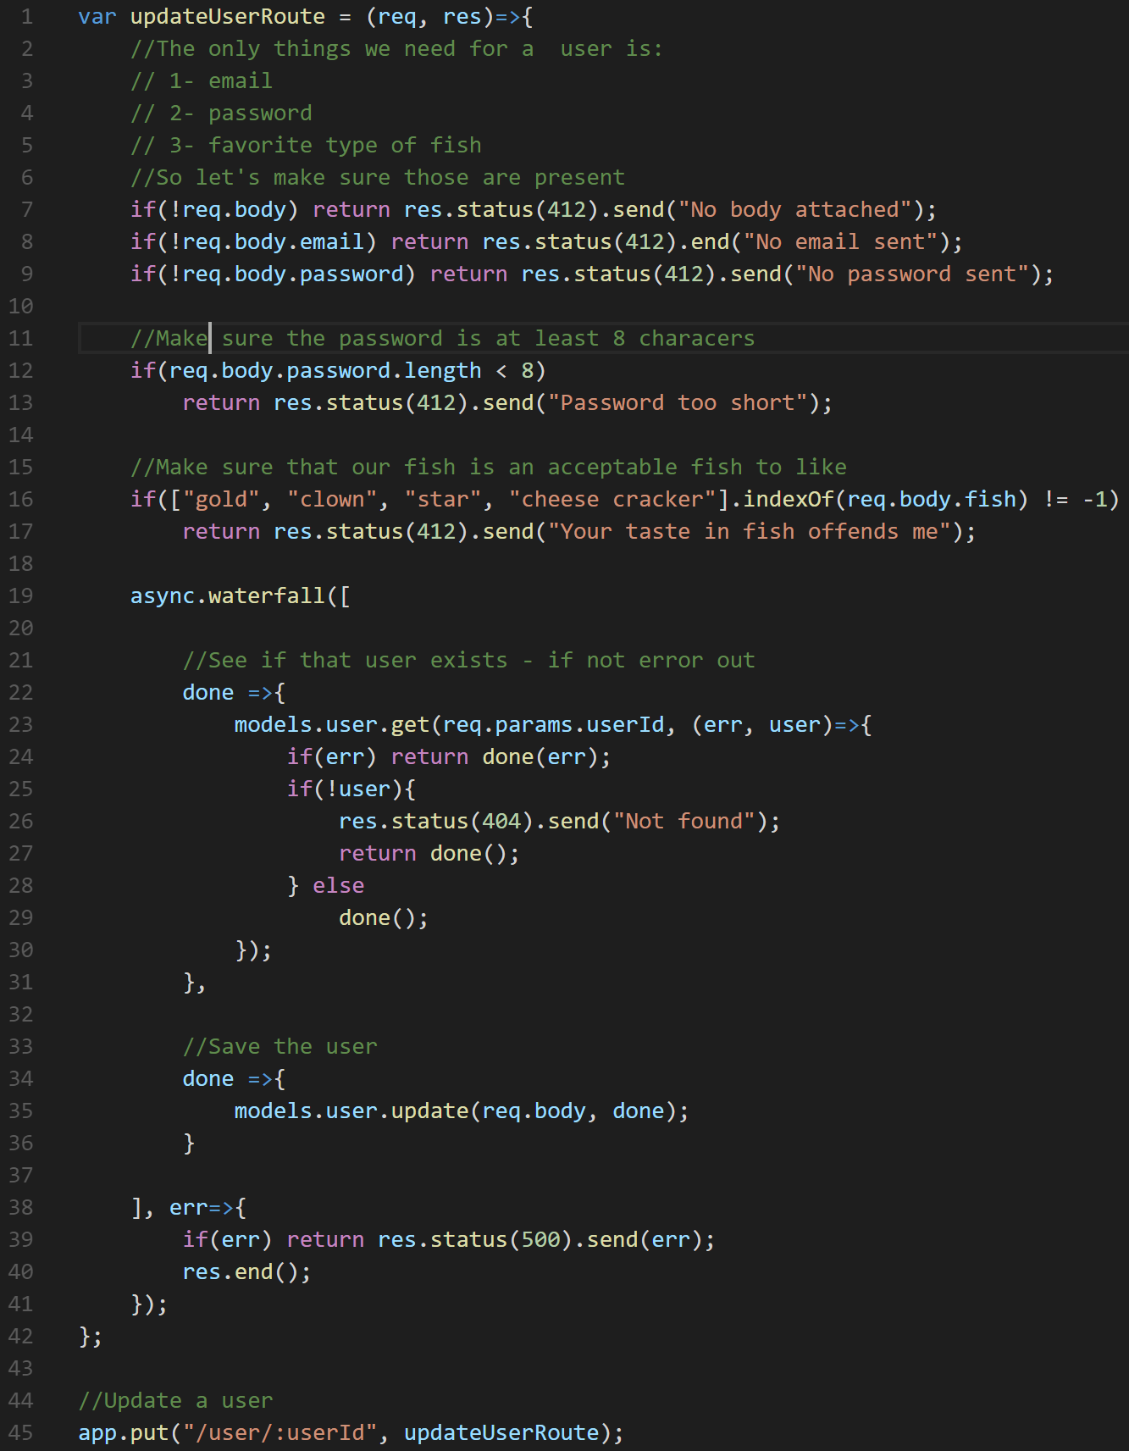
Define the route function separately
updateUserRoute can now be brought in seperately for testing without needing to run an Express server
updateUserRoute can easily be placed in a collection of routes organized by grouping. I often do this for my APIs
By doing this, I’m no longer effected by Express and I’m not testing Express (it already has its own tests – it doesn’t need mine)

Slide 26
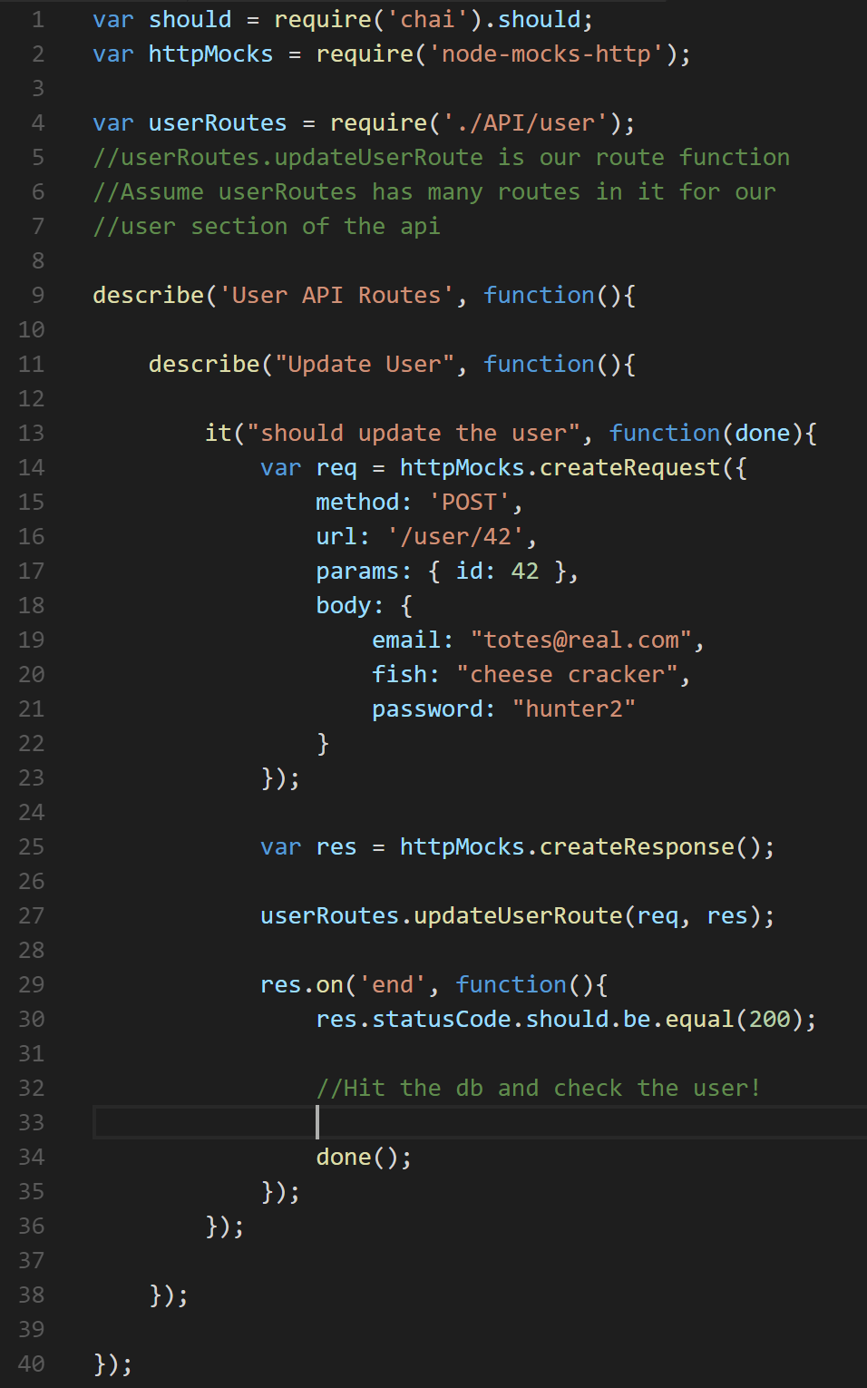
Testing a separate route

Slide 27
What else can we break out?
Depends on your organization and complexity!
Validation
The same checks over and over can just become testable middleware for re-use
Business Logic
Given a complex enough route, the logic can be broken out into an additional separate unit (I don’t do this much)
Middleware

Slide 28
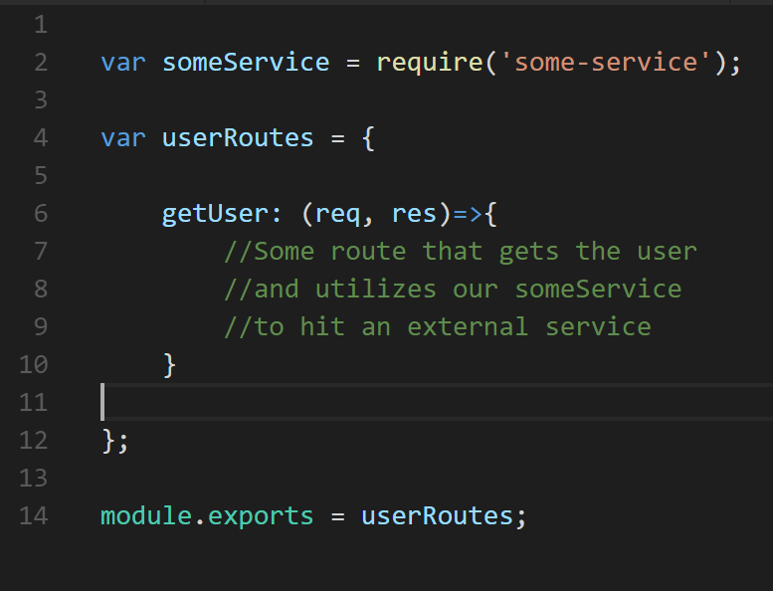
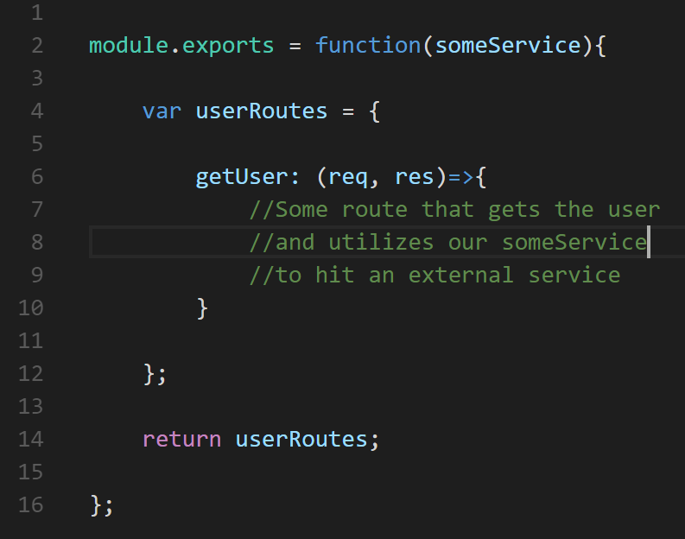
Organizing your code for mocking
VS

Slide 29
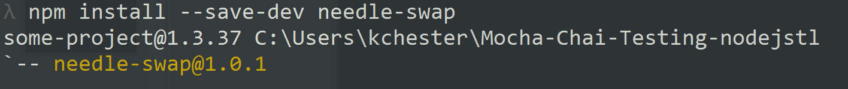
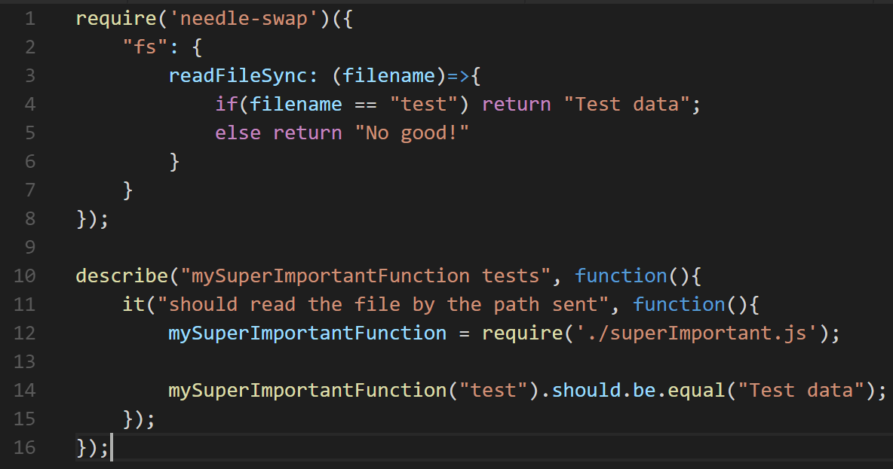
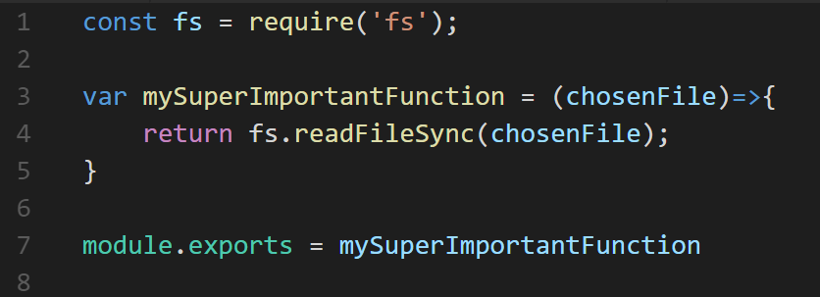
needle-swap
Dirty Dependency Injection
https://github.com/hlfshell/needle-swap

Slide 30
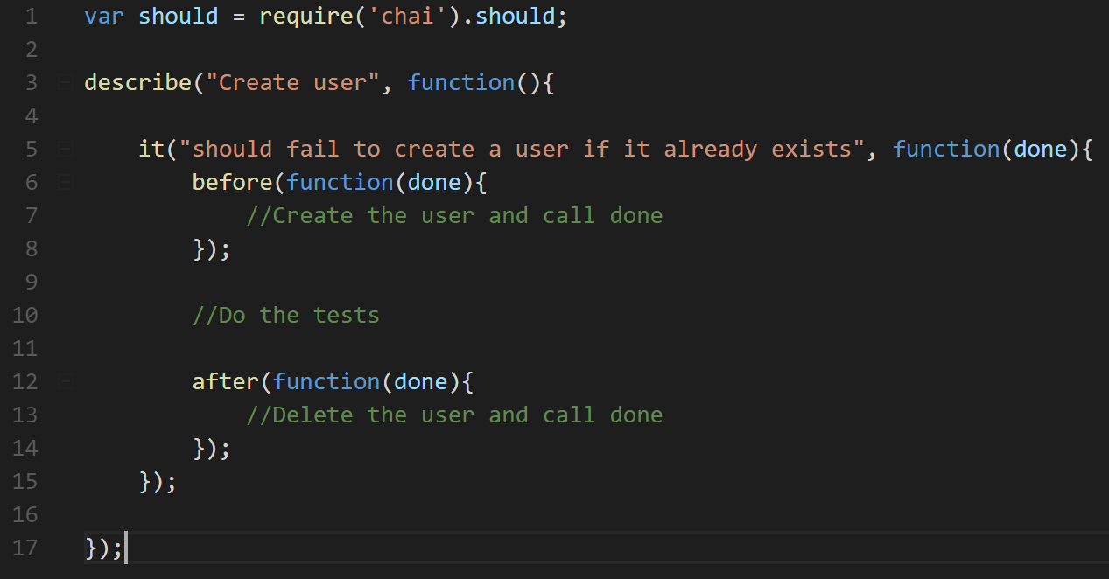
Prepping data for your tests
before beforeEach afterEach after

Slide 31
Fin
Questions?

